Slide 1
ACADEMIC PERFORMANCE FORECASTING
Guided by - Mrs.E.Pooja (Assitant Professor ,CSBS)
Presented by
Harini. J CSBS
Manisha Devi. S CSBS
Dhakshna Moorthy. D CSBS

Slide 2
INTRODUCTION
ABSTRACT:
In the subject of education, predicting student marks is an important area for research and application. Student can predict their future academic achievement by using past data and Linear Regression algorithm. This prediction is essential for identifying kids who could be at danger of performing below expectations since it enables early intervention and customized support. Academic performance forecasting also helps with curriculum design, resource distribution, and course recommendation systems. The importance and difficulties of student mark prediction are examined in this abstract, along with the possible advantages it may have for enhancing learning outcomes and promoting student achievement.

Slide 3
OBJECTIVES
Early detection of pupils who pose a risk
Tailored assistance and intervention
Resource allocation and curriculum planning
Imparts fundamental information regarding the course
Monitoring and assessing academic performance
Making decisions based on data

Slide 4
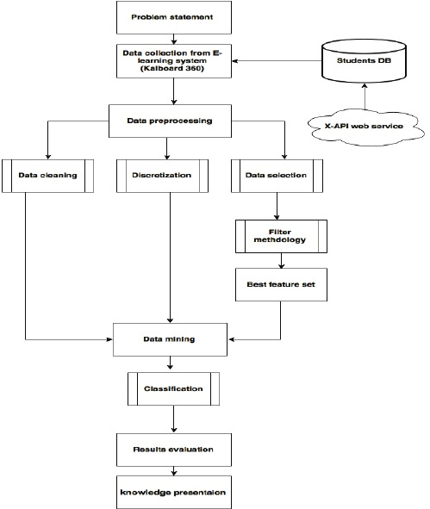
ARCHITECTURAL DIAGRAM

Slide 5
CONCERNING THE DATASET
Dataset-Student mark prediction
Source -https://www.kaggle.com/datasets/yasserh/student-marks-dataset
Survey of students for all courses in school
101 Students observation based on 5 attributes
Target variable 100% (Final score)
Goal: To predict students grade based on previous performances

Slide 6
DATA PREPARATION
No missing values in the dataset
Cateogrical variables transformed to factor variable
Dummy variables used to handle nominal variables
Data set is split into to training and test set in 80:20 ratio
Understand the Dataset & cleanup (if required).
Build Regression models to predict the student marks wrt multiple features.
Also evaluate the models & compare their respective scores like R2, RMSE, etc.

Slide 7
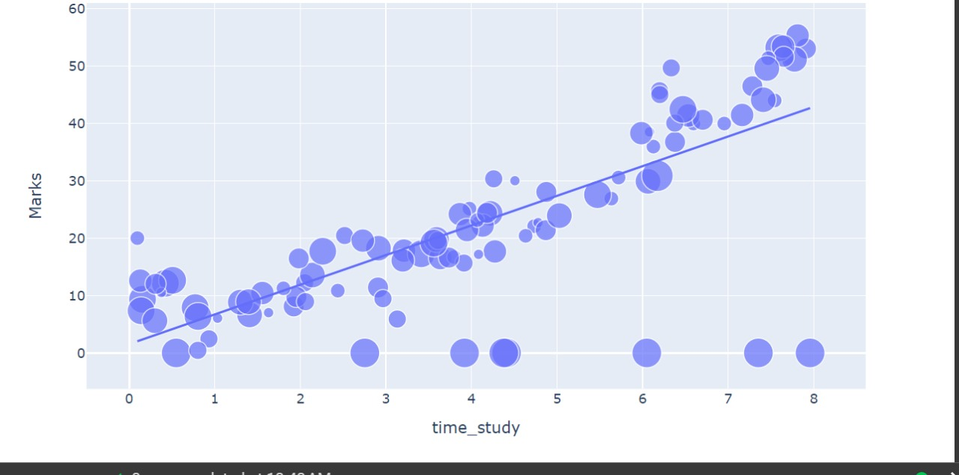
LINEAR REGRESSION
Linear regression is a statistical method used to model the relationship between a dependent variable (often denoted as ( y )) and one or more independent variables (often denoted as ( x )). The relationship is modeled as a linear equation

Slide 8
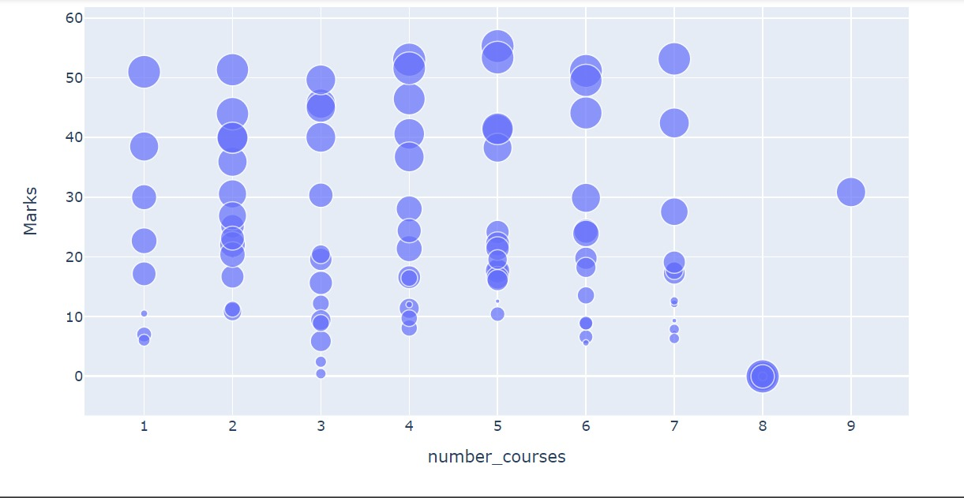
SCATTER PLOT
A scatter plot (aka scatter chart, scatter graph) uses dots to represent values for two different numeric variables. The position of each dot on the horizontal and vertical axis indicates values for an individual data point. Scatter plots are used to observe relationships between variables.

Slide 9
TECHNOLOGICAL STACK
Front end – HTML
Back end – Pyscript ,Jupyter
Data preparation
Data optimization
Data exploration
Data visualaization

Slide 10
ALGORITHM USED
Linear regression Algorithm :
The Train Using AutoML tool uses linear regression, a supervised machine learning technique, to identify a linear equation that best captures the relationship between the explanatory and dependent variables. This is accomplished by use least squares to fit a line to the data. The line seeks to reduce the residuals' sum of squares. The gap between the explanatory variable's true value and its line is known as the residual. Iteratively finding the line of best fit is a procedure.

Slide 11
ADVANTAGES
Early intervention enables teachers to see troublesome pupils early on and offer the appropriate assistance. Personalised learning makes it possible to create study schedules and materials that are specifically catered to each student's needs and expected performance.
Resource optimisation: By predicting student demand for courses, it assists educational institutions in allocating resources as effectively as possible.
Academic counselling: Assists students who are at danger of performing below expectations with focused counselling and support services. Better Outcomes: Prevents problems before they get worse, which improves academic results. Data-Informed Decision Making: Provides administrators and teachers with data-driven insights to guide educational actions and policies.

Slide 12
REFERENCES
Paper in (IJCRT) : efaidnbmnnnibpcajpcglclefindmkaj/https://ijcrt.org/papers/IJCRT2207282.pdf
Paper on (WJARR) : efaidnbmnnnibpcajpcglclefindmkaj/https://wjarr.com/sites/default/files/WJARR-2023-0591.pdf
A study on github : https://github.com/harshit9665/Prediction-of-Student-Marks-through-Regression/blob/master/Prediction%20of%20Student%20Marks%20based%20on%20Study%20Hours.ipynb

Slide 13
THANK YOU

